Slide 1

Bank Loan Analysis
By Soumyaranjan Nayak

Slide 2
AGENDA
INTRODUCTION
KPI
DATA VISUALIZATION
KEY LEARNINGS & INSIGHTS
CONCLUSION

Slide 3

INTRODUCTION

Slide 4
Introduction
In today’s dynamic financial landscape, the effective management of loans is crucial to both banks and borrowers.
A comprehensive analysis of loan data helps financial institutions assess risk, optimize lending strategies, and ensure regulatory compliance.
This presentation will explore key aspects of bank loan analysis, including credit risk assessment, loan performance, and predictive modeling. We will delve into the data-driven methodologies that enable banks to make informed lending decisions, mitigate default risks, and improve customer retention.
Additionally, we’ll examine the impact of external economic factors on loan portfolios and discuss strategies for balancing profitability with responsible lending practices.

Slide 5

Key Performance Indicators (KPIs)
KPI:1-Year wise loan amount
KPI:2- Grade - Sub grade wise revolution balance
KPI:3 – Total payment for verified status Vs Non verified status
KPI:4 – State wise, Month wise loan status
KPI:5 – Home Ownership Vs Last Payment Date status

Slide 6
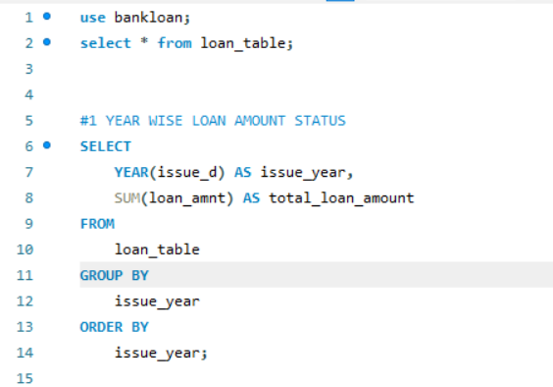
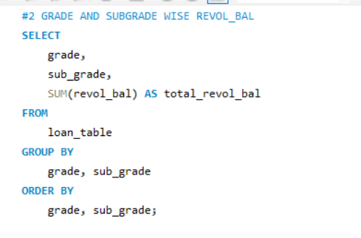
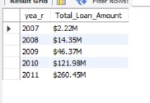
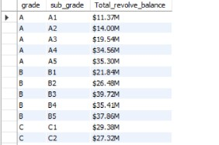
SQL Overview for KPI

Slide 7
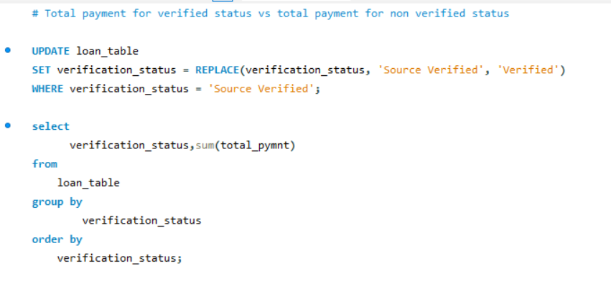
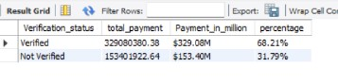
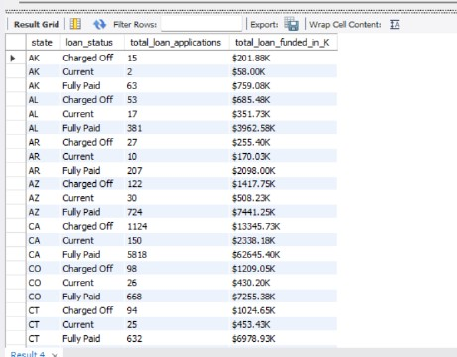
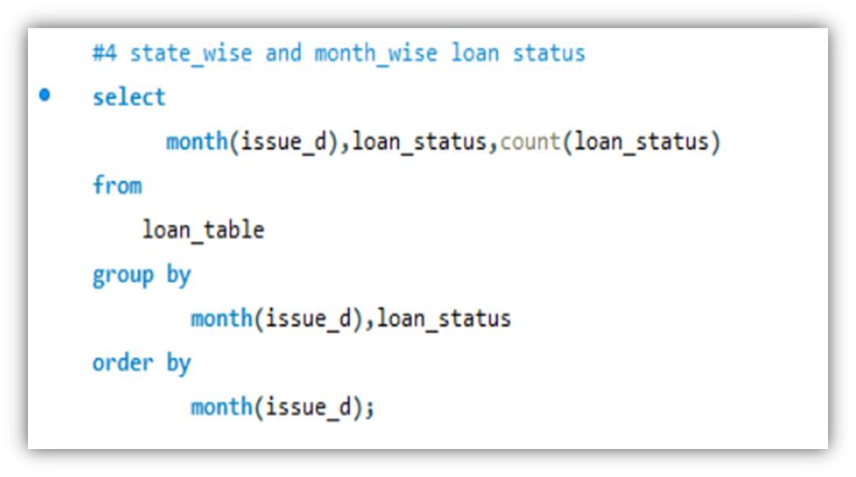

Slide 8
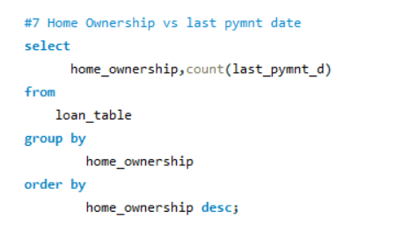
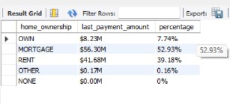

Slide 9

DATA VISUALIZATION

Slide 10
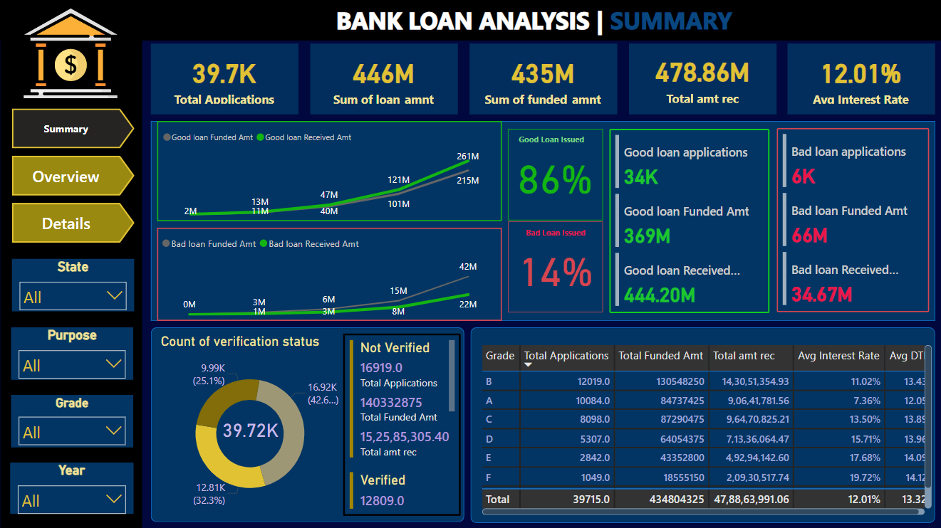
Dashboard

Slide 11
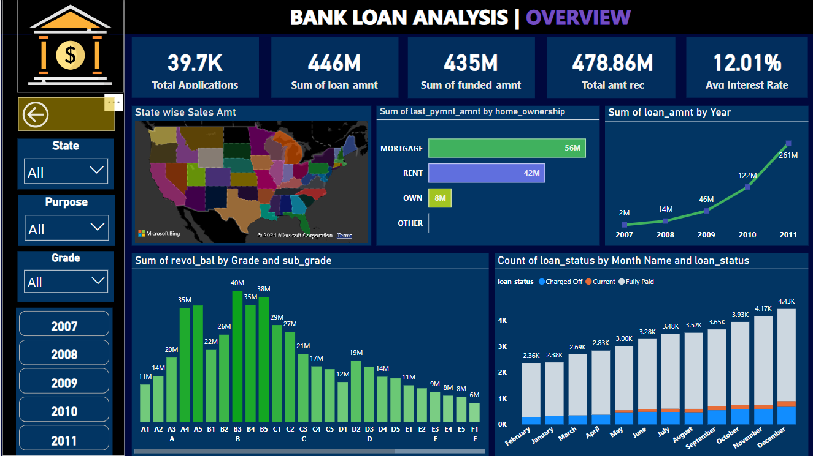
Dashboard

Slide 12
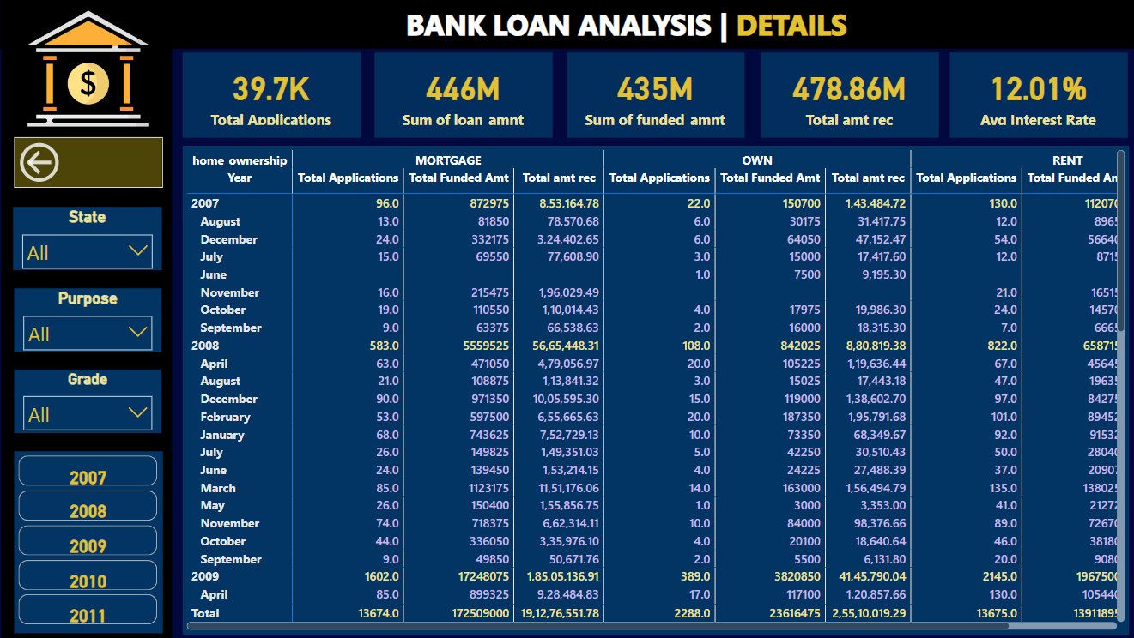
Dashboard

Slide 13
Key Insights
Total Loan Distribution:
Total Loan Amount: $445 million across all states.
Total Fund Amount: $434 million, closely matching the loan amount, indicating that most loans are funded.
Total Revolving Balance: $531 million, meaning many customers are revolving credit, showing a high potential for future interest earnings.
Number of Customers: 39,717, a large customer base representing significant diversity in loan size and types.
Verification Status:
Not Verified: 68.19% of loans have not been verified, which could be a risk factor as unverified loans may have a higher default risk.
Verified: 31.81% are verified, a relatively smaller portion. There might be opportunities to improve the loan verification process.
Home Ownership vs. Loan Repayment:
Customers with Rent (41.69%) and Mortgage (56.31%) make up a significant portion of loans, indicating that most borrowers have some form of housing expense.
A smaller percentage of loan customers own homes outright, which could mean more financial obligations for these borrowers, affecting loan repayment capacity.

Slide 14
Key Insights
Top Loan States:
California (CA) leads with the highest loan amount at $80.36 million, followed by New York (NY) with $42.97 million and Texas (TX) at $31.90 million. These states may represent growth markets but also possible concentration risk.
The Bottom 10 States, such as Montana (MT) and South Dakota (SD), show very low loan amounts, suggesting either untapped markets or areas with less demand.
Year-wise Loan Growth:
The loan amount has steadily increased from $46.44 million in 2009 to $260.51 million in 2011, highlighting growth in the loan portfolio and suggesting potential for continued expansion.
Grade and Sub-Grade Loan Performance:
Grades B and C show the highest revolving balance, with Grade B sub-categories B1, B2, and B5 leading in balances. These grades likely represent a significant portion of the loan portfolio, with possible higher interest rates.
Lower-grade loans like Grade D and E also show notable revolving balances, possibly indicating higher-risk borrowers with higher balances.

Slide 15
Recommendations
Improve Loan Verification:
Focus on increasing the percentage of verified loans to mitigate risk. Automating or improving the verification process may enhance loan quality and reduce defaults.
Diversification of Loan Markets:
States like Montana, South Dakota, and Vermont have very low loan amounts. Consider targeted marketing campaigns or tailored financial products to increase loan penetration in these states.
Seasonal Loan Promotions:
The spike in loans towards the end of the year suggests opportunities for seasonal loan promotions. Consider launching special loan products or offers leading into the holiday season to capitalize on demand.
Credit Grade Risk Assessment:
Since Grades B and C represent the largest portion of revolving balances, it’s essential to closely monitor these borrowers. Implement stricter credit assessments or revise interest rates to manage risk in these categories.

Slide 16
Recommendations
Focus on High-Performing States:
States like California, New York, and Texas drive a significant portion of the loan amount. These could be ideal regions for further product expansion or customer retention strategies. However, be mindful of concentration risk and consider spreading out exposure.
Customer Retention and Education:
With nearly 40,000 customers, implementing customer retention programs focusing on financial literacy, especially on loan repayment, could improve payment behavior and customer loyalty.
Interest Rate Strategy:
With an average interest rate of 12%, consider reviewing how competitive this rate is within the market. Offering flexible rates based on credit grade or customer history may help attract lower-risk customers and boost loan uptake.

Slide 17

Conclusion
In conclusion, bank loan analysis is a critical tool that enables financial institutions to make informed lending decisions, optimize their portfolios, and mitigate risk. Through data-driven insights, banks can assess creditworthiness, identify high-risk loans, and enhance profitability while maintaining regulatory compliance.
As we have explored, leveraging advanced analytics, predictive models, and technology allows banks to navigate the complexities of loan management efficiently. From customer segmentation and risk-based pricing to stress testing and fraud prevention, loan analysis provides the foundation for strategic decision-making in today’s dynamic financial environment.
By applying these methodologies, banks can balance risk and reward, maintain financial stability, and foster sustainable growth. Ultimately, effective loan analysis not only strengthens the bank’s operations but also improves customer relationships and drives long-term success.

Slide 18


Slide 19


